Slide 1


MAPD-B final project Data processing
Setting an upper limit
on the branching ratio of FCNC
$t\overline{t}$ processes with CMS data:
a distributed approach
^{14th} juLY 2021
Chiara Maccani Samuele Piccinelli
Tommaso Stentella Cristina Venturini

Slide 2



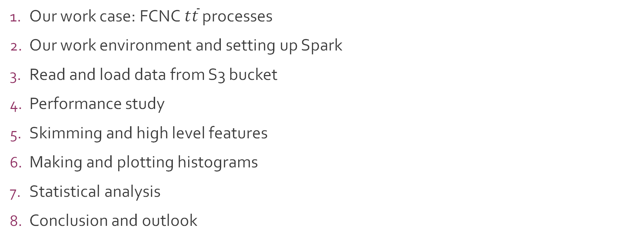
overview
Our work case: FCNC $t\overline{t}$ processes
Our work environment and setting up Spark
Read and load data from S3 bucket
Performance study
Skimming and high level features
Making and plotting histograms
Statistical analysis
Conclusion and outlook

Slide 3

1 – fcnc $t\overline{t}$processes

Slide 4
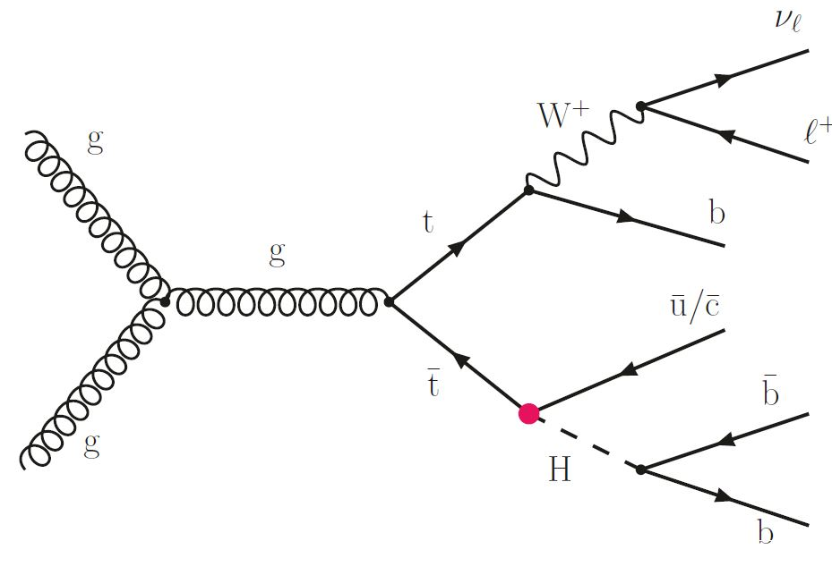
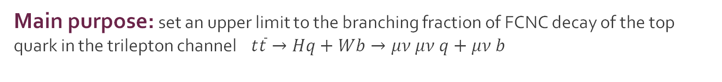
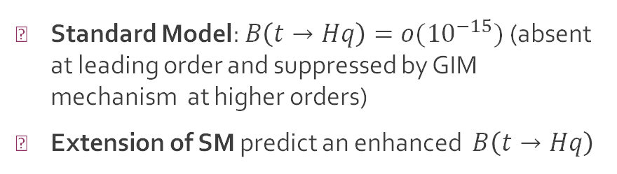

FCNC decay of the top quark to the Higgs boson
Flavour changing neutral currents are weak interactions that change the flavour of a fermion without altering the electric charge.
Our analisys focuses on $t\overline{t}$ processes.
Standard Model: $B\left(t→Hq\right)=o({10}^{−15})$ (absent at leading order and suppressed by GIM mechanism at higher orders)
Extension of SM predict an enhanced $B\left(t→Hq\right)$
New physics?
Main purpose: set an upper limit to the branching fraction of FCNC decay of the top quark in the trilepton channel $t\overline{t}→Hq+Wb→μν μν q+μν b$

Slide 5
FCNC decay of the top quark to the Higgs boson
Trilepton channel: $t\overline{t}→Hq+Wb→μν μν q+μν b$
Final states:
3 muons (with isolation parameter < 0.15 and transverse momentum > 15 GeV)
0 isolated electrons electrons
≥ 2 jets
≥ 1 b-jets
Our data:
Simulated FCNC samples
Simulated Background: Single Top, Top-Top, Diboson, other processes (QCD, Drell Yan )
CMS Data (Run 2016/2017/2018)
~ 50 GB of file .root containing 19.000.000 events stored into a nested TTree structure
A distributed approach with Spark can help with the analysis

Slide 6
2 – our work environment & setting up spark

Slide 7
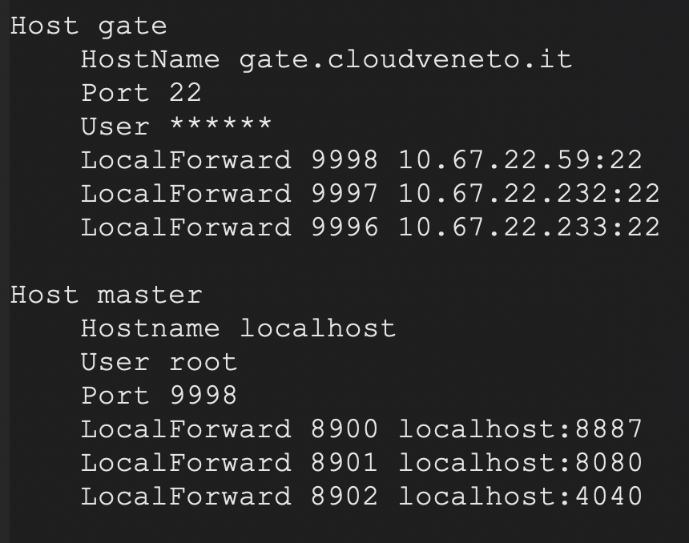
Our work environment & setting up spark
3 VM on CloudVeneto: one with 8 cores and 16 GB of memory, two with 4 cores and 6 GB of memory
The first one employed as master, with two executors running
The others employed as workers, with one executor each
As a useful tool for an easy connection with the cluster from personal laptop a file .ssh/config has been used

Slide 8
3 – Read and load data from S3 bucket

Slide 9
Read and load data from S3 bucket
Data ingestion is the first stage of the process; files are stored in an Amazon S3 bucket.
An Amazon S3 bucket is a public cloud storage resource available in Amazon Web Services' (AWS) Simple Storage Service (S3). Here we read the ROOT file from S3 bucket into a Spark dataframe by reading the access ID and key from the ~/.s3cfg file:
access_id = config.get('aws_profile', 'access_key') access_key = config.get('aws_profile', 'secret_key')

Slide 10
Read and load data from S3 bucket
In order to use Hadoop, one needs to first configure it by creating a configuration object.
The configuration holds information about the job tracker, the input, output format and various other parameters.
It is necessary to properly configure and bootstrap Hadoop in order to submit the required jobs.
hadoop_conf=sc._jsc.hadoopConfiguration() hadoop_conf.set('fs.s3n.impl', 'org.apache.hadoop.fs.s3native.NativeS3FileSystem') hadoop_conf.set('fs.s3n.awsAccessKeyId', access_id) hadoop_conf.set('fs.s3n.awsSecretAccessKey', access_key)

Slide 11
READ AND LOAD DATA
The data files are read into a Spark dataframe by means of a custom data loader (readRoot()).
Ad-hoc libraries are avoided:
The DIANA-HEP library handles Spark DataFrame objects but is no longer mantained and poses compatibility problems between libraries;
The ROOT.RDF.Experimental.Distributed Python library, which extends the functionalities of ROOT DF in a distributed environment;
PyRDF, a pythonic wrapper around ROOT’s RDataFrame with support for distributed execution.
All this solutions posed some techical issues to the implementation or were unsuited for the specific task.

Slide 12

Read and load data
We read the .root files in Numpy through the Uproot library.
Uproot is only an I/O library, primarily intended to stream data into machine learning libraries in Python.
We convert them in native Python types such as lists, int, float.
pro = uproot.open(file_name + ':Events').arrays(var, library='np')

Slide 13
Read and load data
Reading is done on the whole ~42 GB dataset, trying to avoid iterating over each different directory.
each kind of sample is labelled with a different string: data, signal and a different tag for each MC process.
Finally, we instantiate the RDD:
dfRoot = sc.parallelize(fileList).flatMap(readRoot).toDF()

Slide 14
4 – performance study

Slide 15
4 - performance study
We briefly investigated how performance changed when varying:
Number of executors
Cores per executor
Memory per executor
Partitions of the files
There’s no golden rule, not even a good rule of thumb, to fix these parameters appropriately.
Most of the decisions are made based on the exact kind of hardware one is working with and by simply investigating which configuration gives the best performance.
One heuristic rule, found in literature, suggests to have a number of partitions equal to 3-4 times the available cores for each executor. Also, it is suggested to adopt a partition size of around 130 MB.

Slide 16
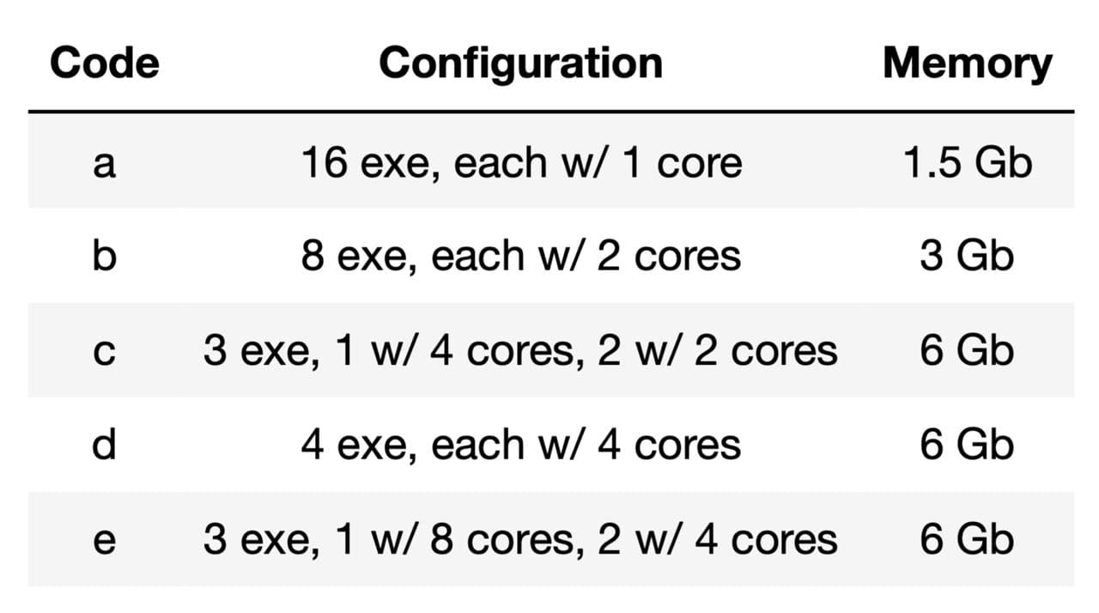
4 - performance study
Accordingly with these considerations, we test the following cores-executors-memory configurations
For each of them, we vary the number of partitions in the set [4, 12, 24, 36, 48, 56, 64] and test their performance by measuring the execution time of a count() action on one of the background directories ‘tZq’ (size: 4.5 GB).

Slide 17
4 - performance study
To perform our evaluation of the elapsed time, we made use of a library called SparkMeasure, which is a tool for performance troubleshooting of Apache Spark jobs.
It simplifies the collection and analysis of Spark performance metrics.
The following function prints the metrics of the Spark job to a json file.
from sparkmeasure import StageMetrics
stagemetrics = StageMetrics(spark)
def sparkmeasure(df, idx, ex):
stagemetrics.begin()
df.count()
stagemetrics.end()
df_out = stagemetrics.create_stagemetrics_DF('PerfStageMetrics’) stagemetrics.save_data(df_out, './perf_test/stagemetrics_{}_{}'.format(ex, idx))
We then retrieve the results and access the elapsed time, the entry we analyzed.

Slide 18
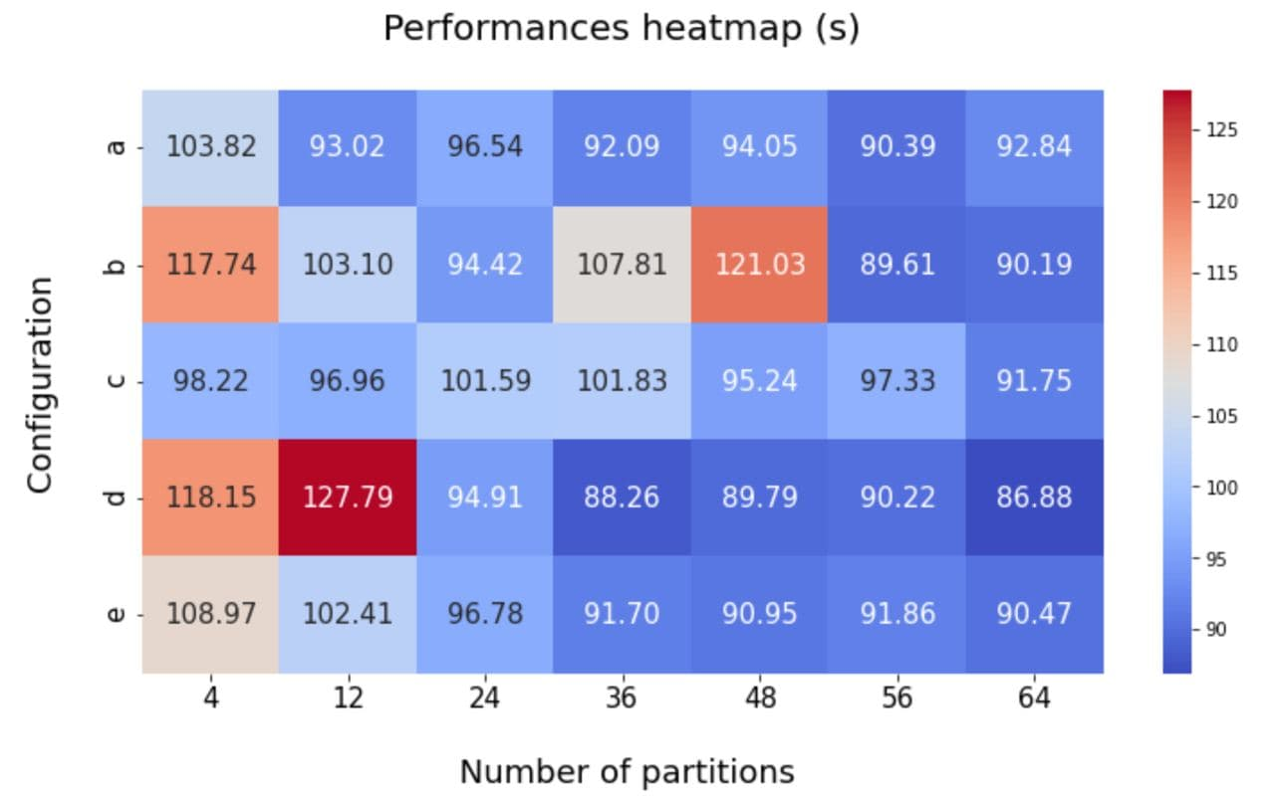
4 - performance study
As one can see, apart from some configurations which perform evidently worse than the others (20-30 seconds more), almost all the others employ a similar execution time.

Slide 19
4 - performance study
The best configuration is d with 64 number of partitions.
Nevertheless, by looking at d with 36 partitions we have a good performance aswell, which agrees with the heuristic rule found in literature.

Slide 20
5 – skimming and high level features

Slide 21
5.1 - SKimming
After loading the data, the next step consists in skimming the dataframes:
We apply filters to retain the events we are interested in
We create new columns to aide us in the subsequent step of creating high level features
To do so, we define a function skimmer(df) which uses 3 Spark transformations:
withColumn(), to define new columns containing:
masks based on specific conditions
new variables
filter(), to discard events not respecting certain conditions
drop(), to drop useless columns

Slide 22
5.1 - SKimming
In particular, inside withColumn(), we call a series of UDFs (User Defined Function). The decorator is imported from the correspondent PySpark library.
When working with UDFs it's important to specify the correct return type, otherwise an error will arise. To do so, we use the appropriate library.
import pyspark.sql.functions as pf
import pyspark.sql.types as pt
arr = pt.ArrayType
maskMu = pf.udf(lambda iso, pt: [True if i < .15 and p > 15 else False for i,p in (iso,pt)],
arr(pt.BooleanType()))
maskEl = pf.udf(lambda iso: [True if i < .15 else False for i in iso], arr(pt.BooleanType()))
apply_mask_long = pf.udf(lambda x, mask: [i for i,m in (x,mask) if m], arr(pt.LongType()))
apply_mask_doub = pf.udf(lambda x, mask: [i for i,m in (x,mask) if m], arr(pt.DoubleType()))
count_col = pf.udf(lambda m: ((m)), pt.IntegerType())

Slide 23
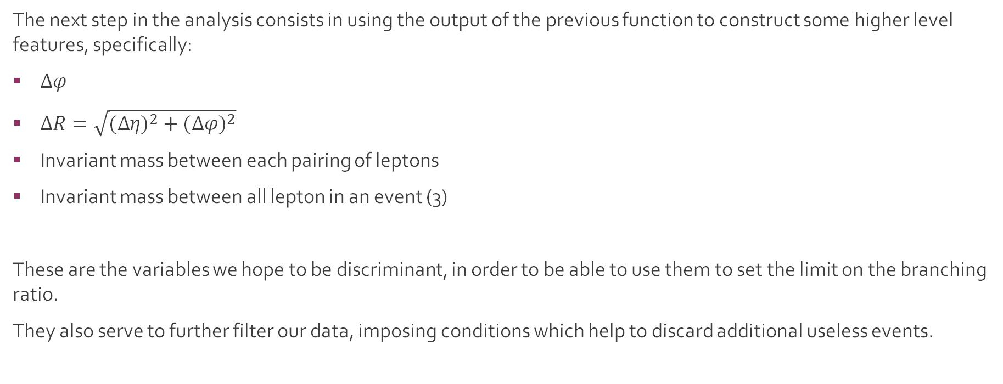
5.2 – high level features
The next step in the analysis consists in using the output of the previous function to construct some higher level features, specifically:
$∆φ$
$∆R=\sqrt{{(∆η\text{)}}^{2} + {(∆φ\text{)}}^{2}}$
Invariant mass between each pairing of leptons
Invariant mass between all lepton in an event (3)
These are the variables we hope to be discriminant, in order to be able to use them to set the limit on the branching ratio.
They also serve to further filter our data, imposing conditions which help to discard additional useless events.

Slide 24
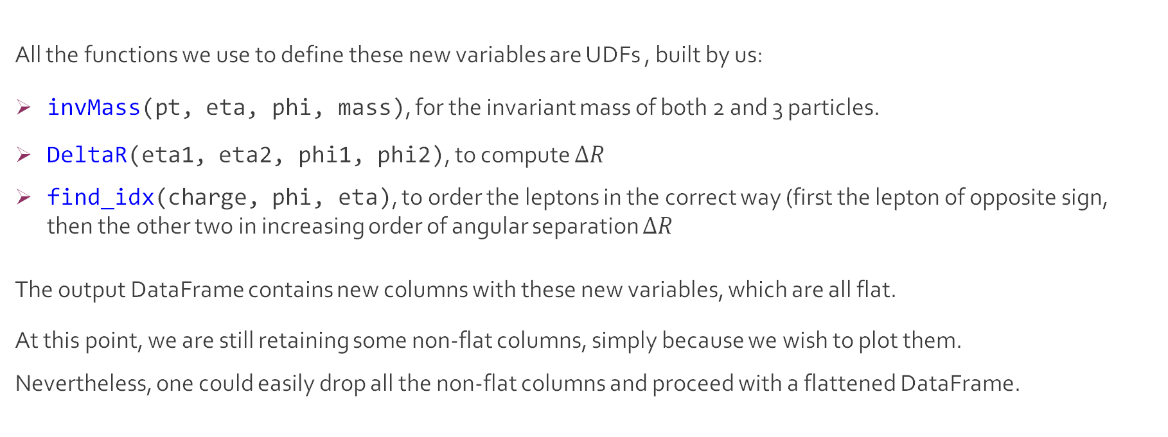
5.2 – high level features
All the functions we use to define these new variables are UDFs , built by us:
invMass(pt, eta, phi, mass), for the invariant mass of both 2 and 3 particles.
DeltaR(eta1, eta2, phi1, phi2), to compute $∆R$
find_idx(charge, phi, eta), to order the leptons in the correct way (first the lepton of opposite sign, then the other two in increasing order of angular separation $∆R$
The output DataFrame contains new columns with these new variables, which are all flat.
At this point, we are still retaining some non-flat columns, simply because we wish to plot them.
Nevertheless, one could easily drop all the non-flat columns and proceed with a flattened DataFrame.

Slide 25
6. Making and plotting histograms

Slide 26
HISTOGRAMS
Goal : plot the stacked backgrounds' histograms , overlap data, plot the shape of simulated signal
Parallelize the creation of histograms, by mapping functions on the rows and splitting into 3 flows (data, signal, bkg) based on 'sample'
A Map – Reduce By Key approach is used
histos = dict(
data.select([variable, 'eventWeightLumi', 'sample'])
.rdd
.map(lambda x: histo(x[ variable], x['eventWeightLumi'], x['sample'],
range_ = interval, bins = nbins) )
.reduceByKey(lambda x,y : (x[0], x[1]+y[1]))
.take(50)
)

Slide 27
HISTOGRAMS
RDD object has a function .histogram() but it does not take into account weights
We decide to implement our own function
def histo (variable, weight, sample, range_, bins):
…
computes the edges of bins, scans the limit's couples and looks for the bin in which
falls value of the variable in the row in
examination, then multiplies for the weight.
counts is a list of length bins of the type [0, 0, … , weight, 0, 0]
...
return (sample, [edges, counts])

Slide 28
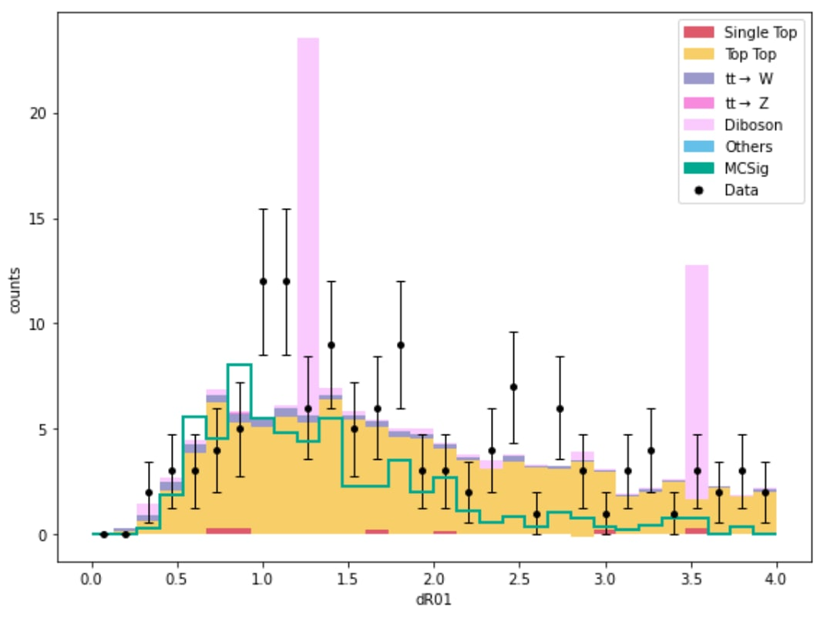
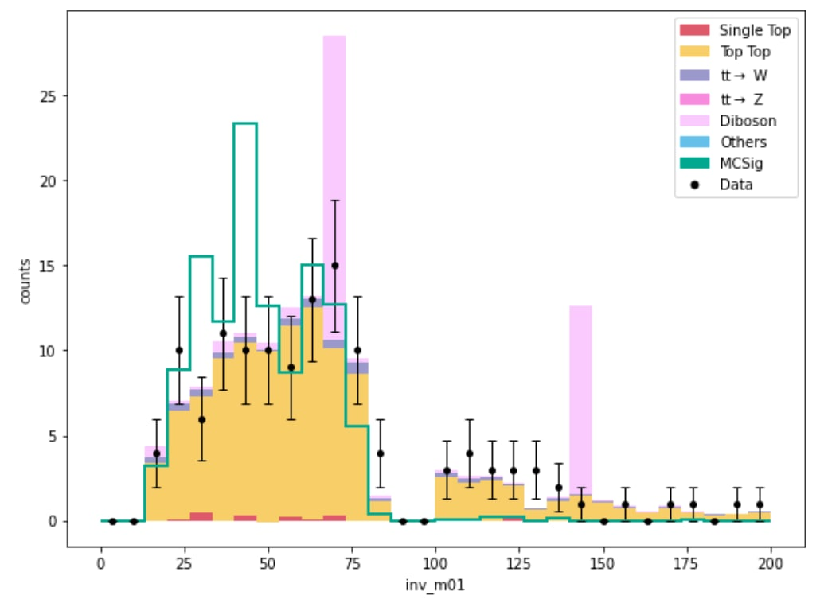
HISTOGRAMS

Slide 29
7 – Statistical analysis

Slide 30
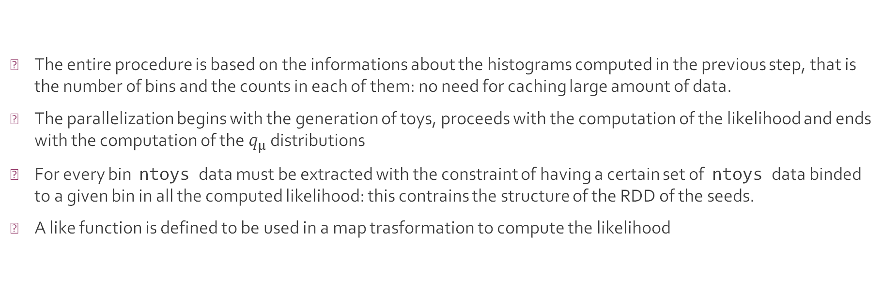
Statistical analysis
The entire procedure is based on the informations about the histograms computed in the previous step, that is the number of bins and the counts in each of them: no need for caching large amount of data.
The parallelization begins with the generation of toys, proceeds with the computation of the likelihood and ends with the computation of the $q_{μ}$ distributions
For every bin ntoys data must be extracted with the constraint of having a certain set of ntoys data binded to a given bin in all the computed likelihood: this contrains the structure of the RDD of the seeds.
A like function is defined to be used in a map trasformation to compute the likelihood
def like(x, mu_sig, bkg, mu_best):
from prod.stats import pisson as ps
return np.prod(ps.pmf(x, mu_sig)), np.prod(ps.pmf(x, bkg)), np.prod(ps.pmf(x, mu_best))

Slide 31
Statistical analysis
The aim is to parallelize the generation of the toys data
Two possible approaches:
Extreme parallelization: all the ntoys × nbin in a single list parallelized to RDD, then reduce by key to reobtain the binding with bins.
Not effective parallelization: too many seeds with respect to the number of cores, does not exploit optimized vectorization with a single core.
The best approach is to split the number of toys to be generated in smaller chunks which can be effectively manipulated in a vectorized way by a single core thanks to libraries like Scipy.

Slide 32
Statistical analysis
toys = sc.parallelize(
np.concatenate((np.tile(np.arange(0,ntoys,1),(nbin,1)).T.reshape(ntoys*nbin,1), np.tile(b_plus_sig_mu,(ntoys,1)).reshape(ntoys*nbin,1)),axis=1))\
.map(lambda x: (x[0], ps.rvs(x[1]))).reduceByKey(lambda x,y: flatten(x,y))\
.map(lambda x: np.array(x[1])
)
toys = sc.parallelize(
np.tile(b_plus_sig_mu, (ntoys,1))).map(lambda bda x: ps.rvs(x)
)
like_tot = toys.map(lambda x: like(x, b_plus_sig_mu, bkg, b_plus_sig_best))
q_mu = np.array(like_tot.map(lambda x: (-2*np.log(x[1]/x[2]), -2*np.log(x[0]/x[2]))).take(ntoys))

Slide 33
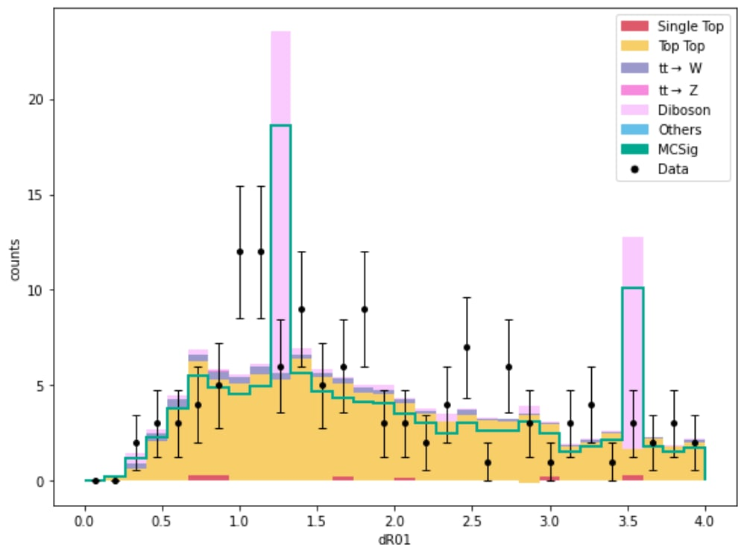
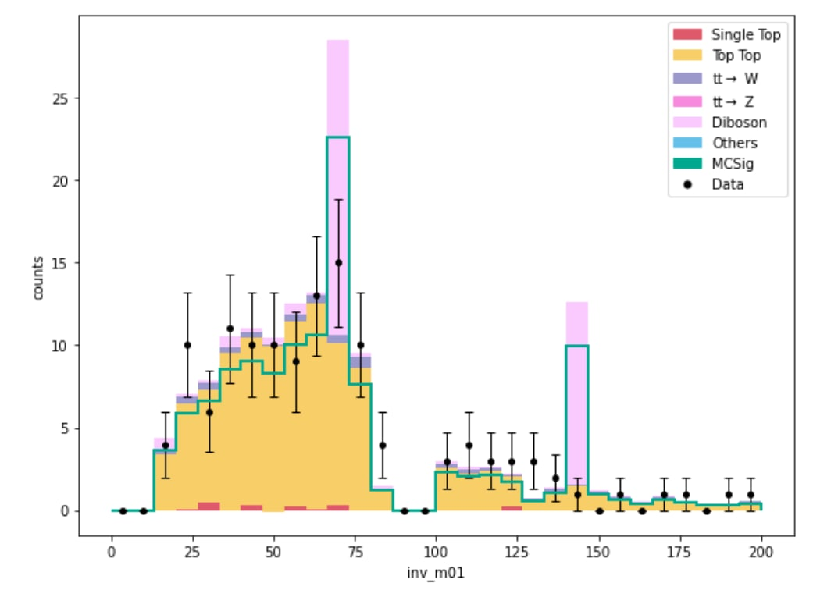
Final histograms

Slide 34
8 – Conclusions and outlook

Slide 35
Conclusion and Outlook
A search for flavor-changing neutral currents events via distributed computing is here presented.
The main advantage lies in a faster access, filtering and parallelized HLF creation: computations are optimized, yet a noticeable advantage wrt. the standardized approach is not significant given the reduced size of the cluster.
Future prospects:
Extend the analysis to the other iSkim categories;
Run the code on a larger cluster.
Main difficulties:
Non-tabular nature of the features stored in .root files;
No standard data loader available;
I/O operations bounded by the network bandwidth in CV.

Slide 36
Thanks for the attention!

